Slide 1

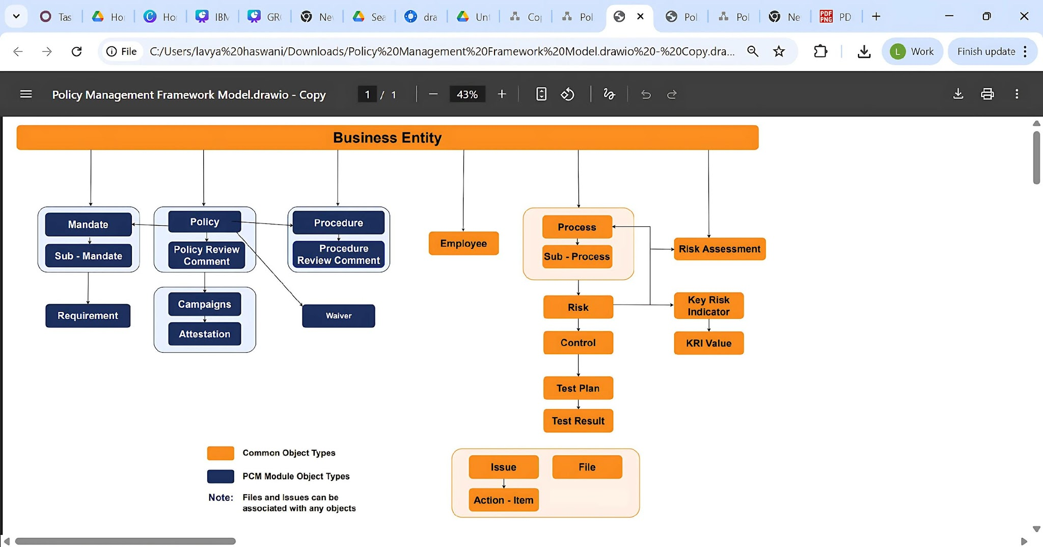
PCM Object Model

Slide 2
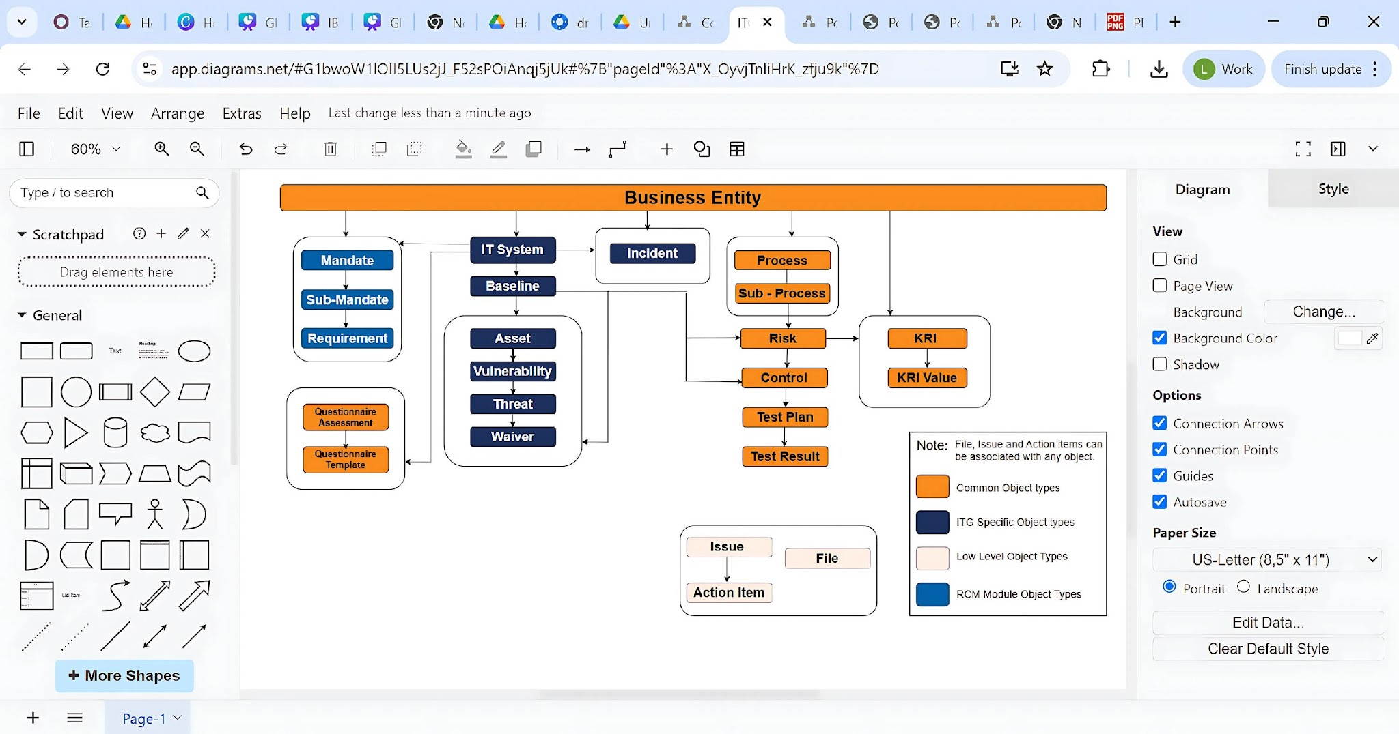
ITG Object Model

Slide 3
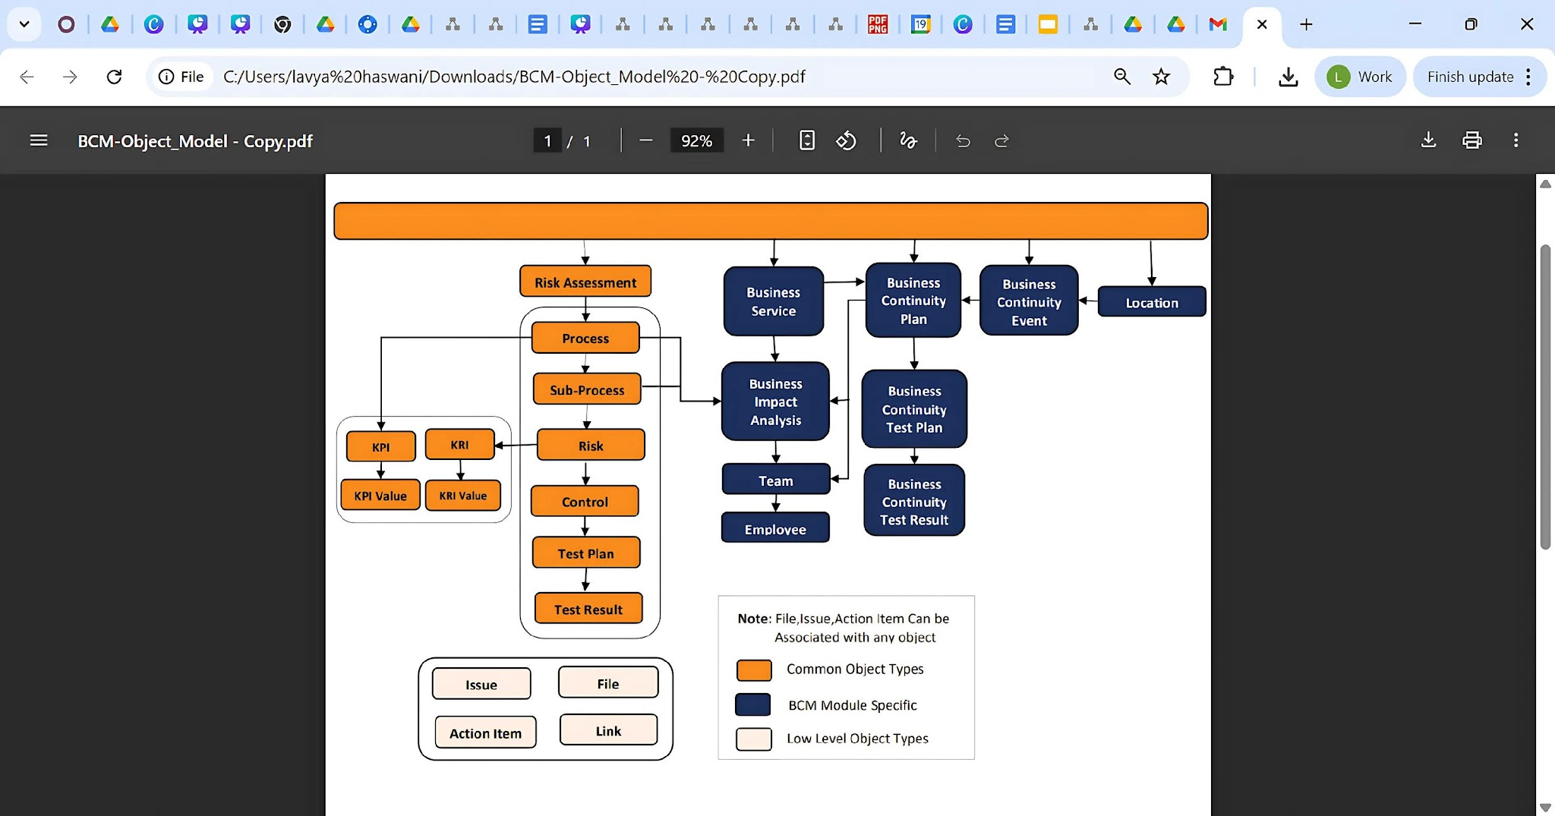
BCM Object Model
Business Entity

Slide 4
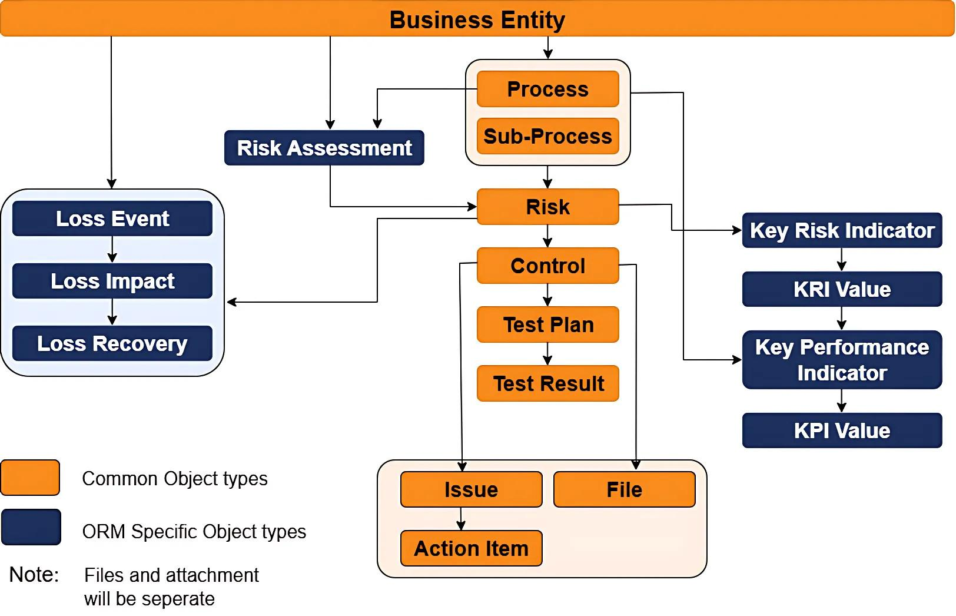
ORM Object Model

Slide 5
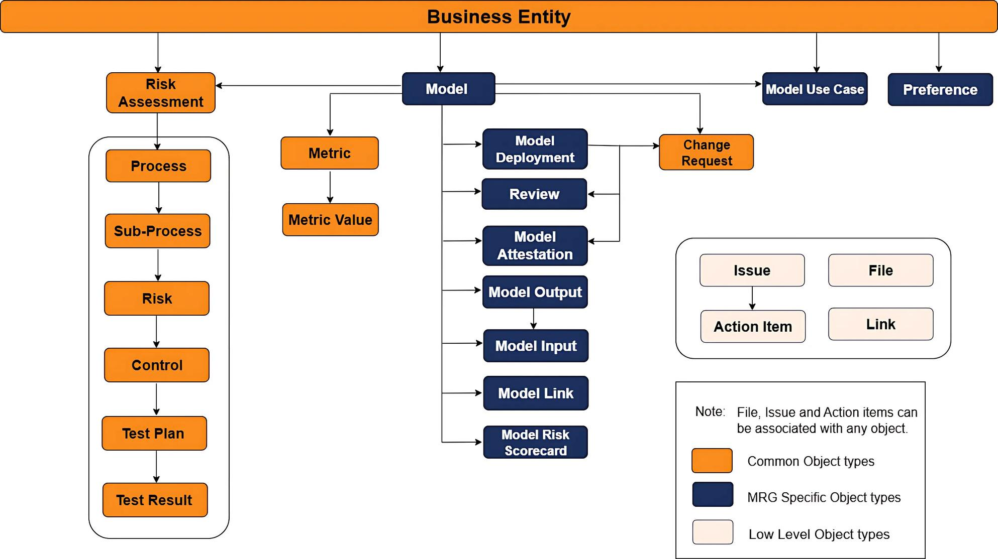
MRG Object Model

Slide 6
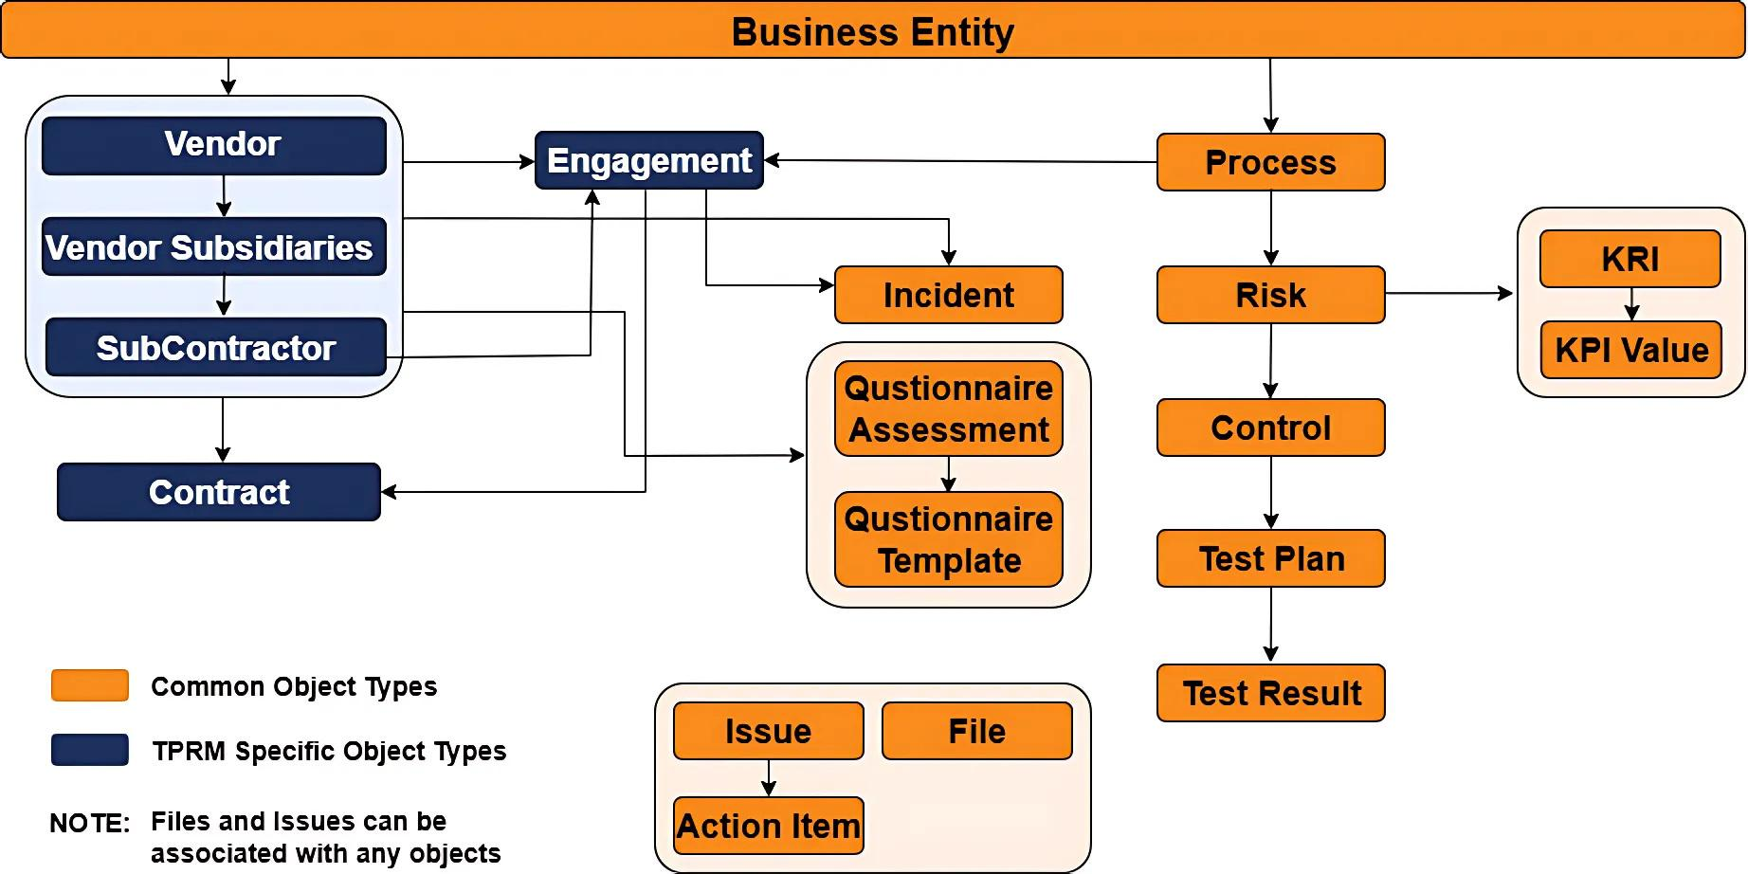
TPRM Object Model

Slide 7
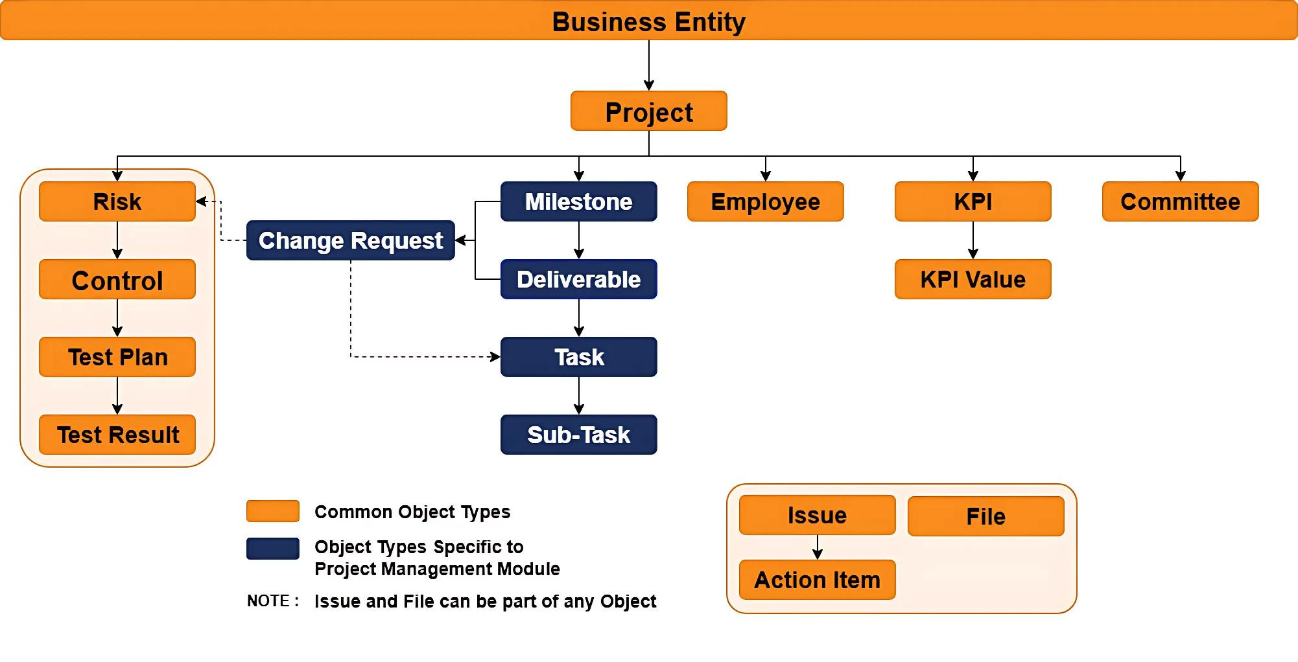
Project Management Object Model

Slide 8
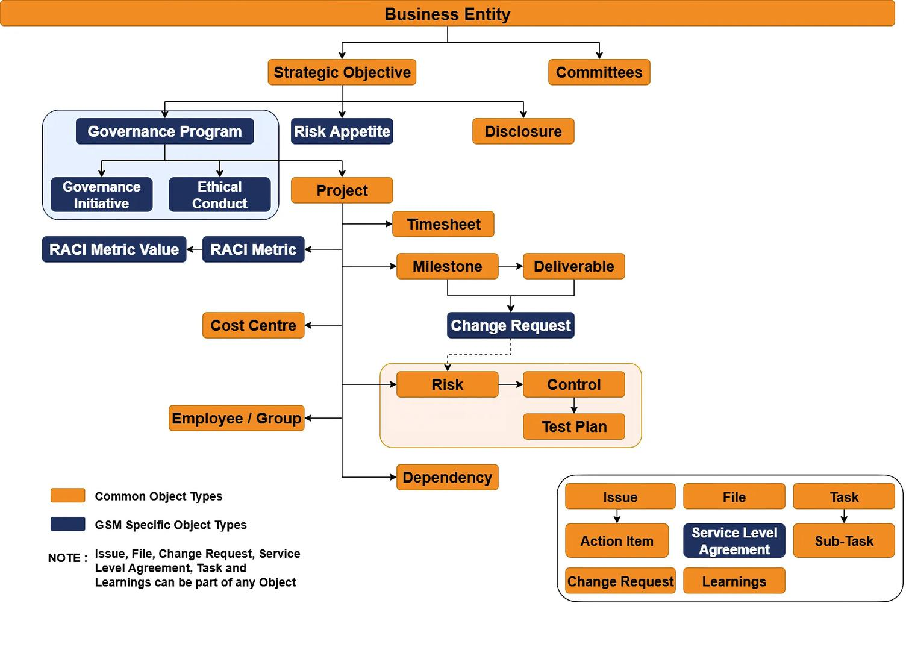
GSPM Object Model

Slide 9
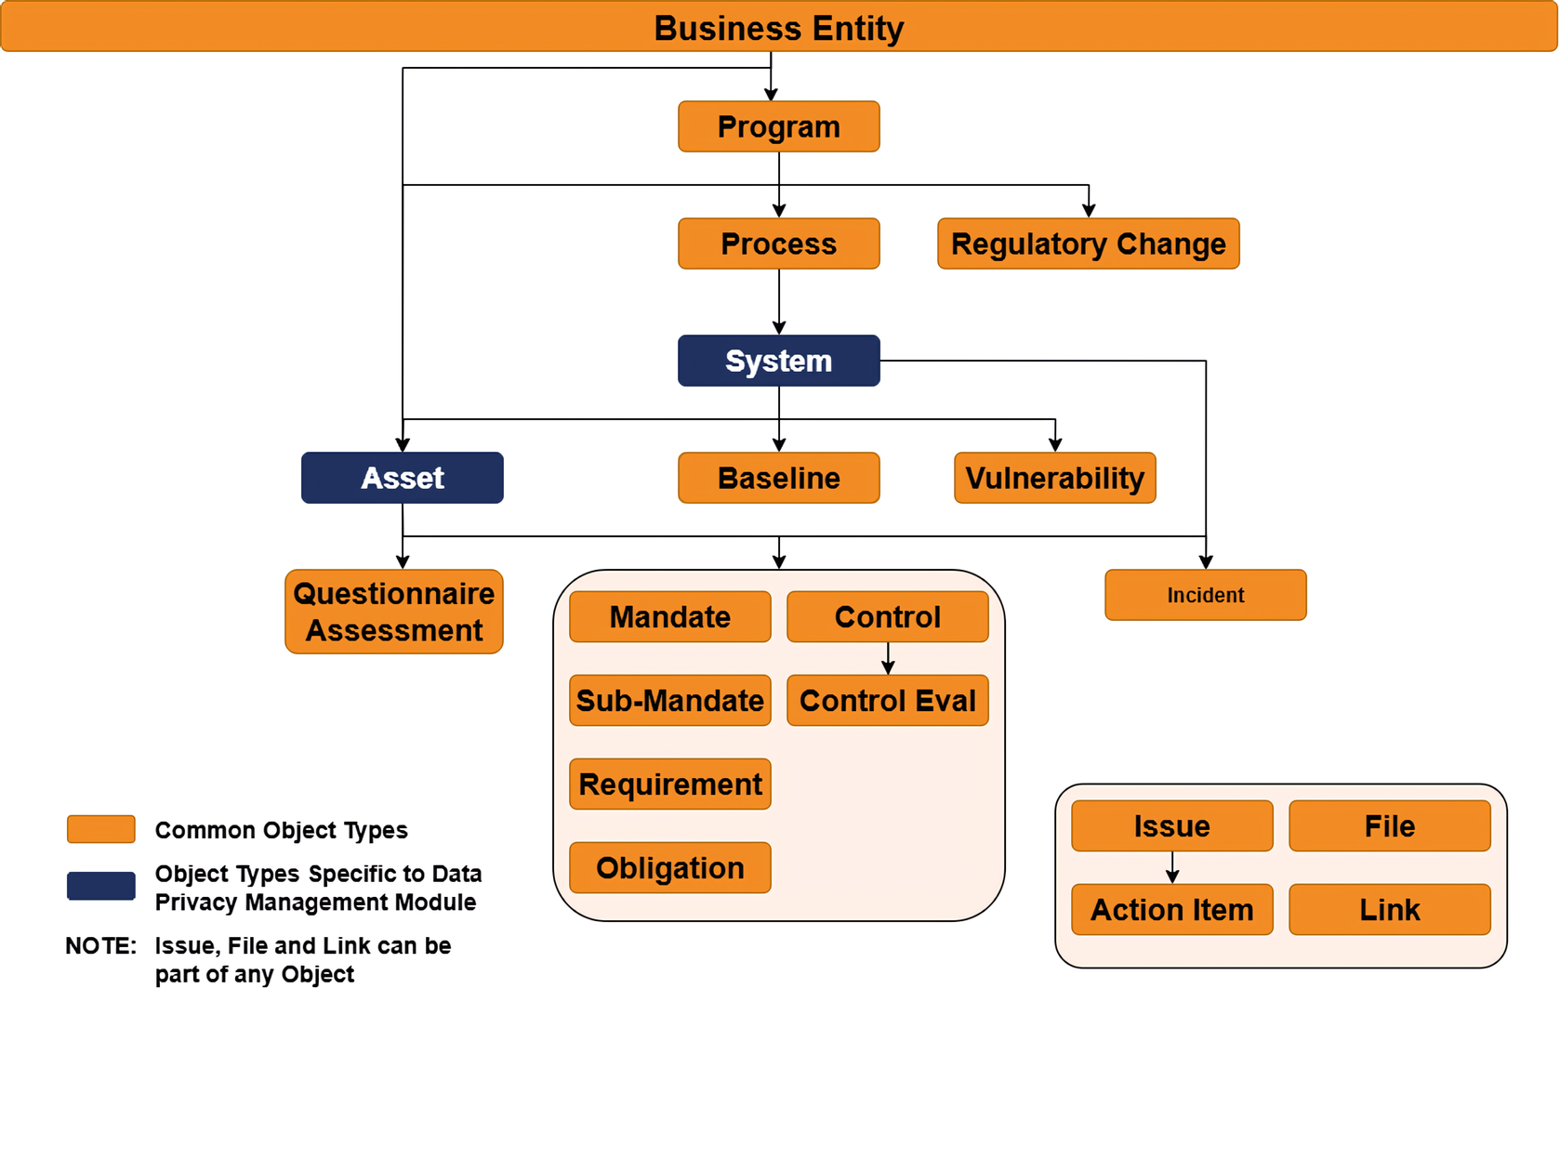
Data Privacy Management Object Model

